Slide 1
Progress report for year 2 (1) M. J. Mendes, O. Sanchez, A. Araújo, A. Vicente, A. Lyubchyk, T. Mateus, H. Águas, E. Fortunato and R. Martins (PI) (2) F. Neves, J. Mascarenhas, A. Barreiros, M. J. Brites, B. Correia, a. Joyce
AltaLuz – Year 2
17 May 2018
(1) i3N/CENIMAT, Department of Materials Science, Faculty of Science and Technology, Universidade NOVA de Lisboa and CEMOP/UNINOVA, Campus de Caparica, 2829-516 Caparica.
(2) LNEG, Laboratório Nacional de Energia e Geologia, Estrada do Paço do Lumiar, 22, 1649-038 Lisboa
Notes:
Vou agora falar sobre os temas de investigação e toda a actividade prevista no projecto. Esta apresentação pretende servir de guia para a nossa discussão seguinte e para o planeamento das actividades

Slide 2
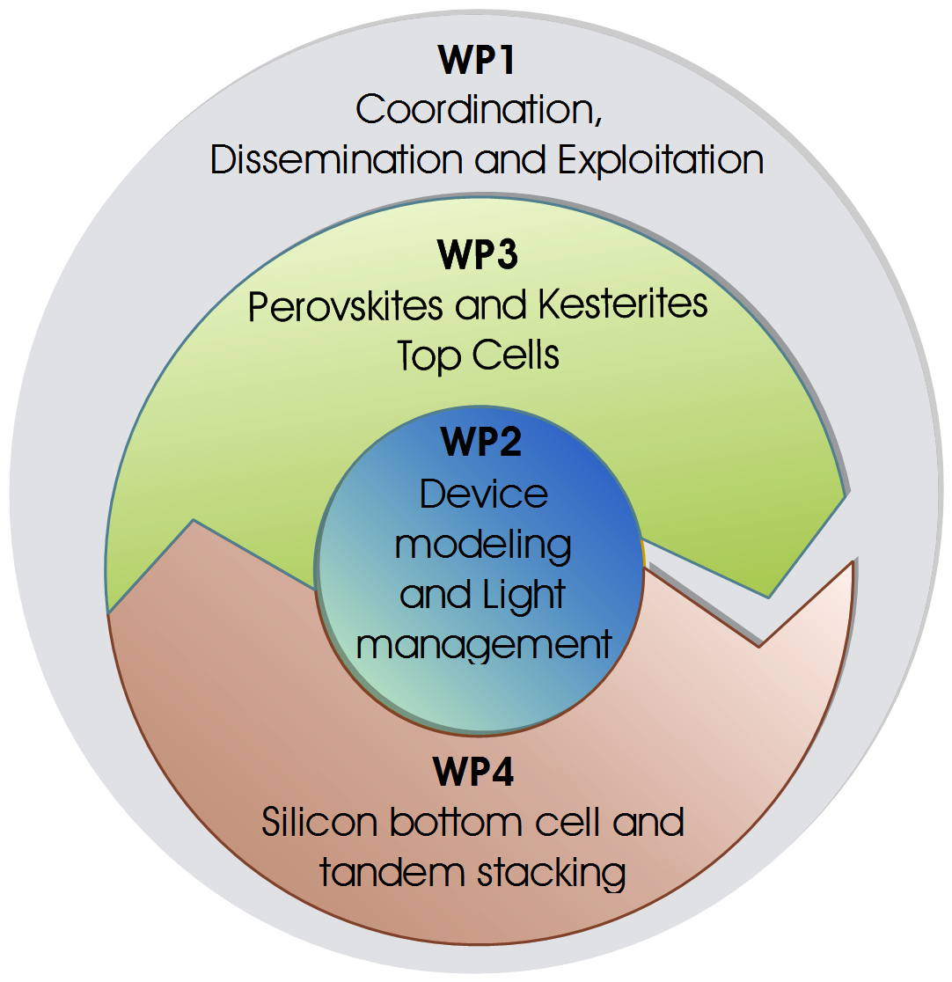
Project Management

Slide 3
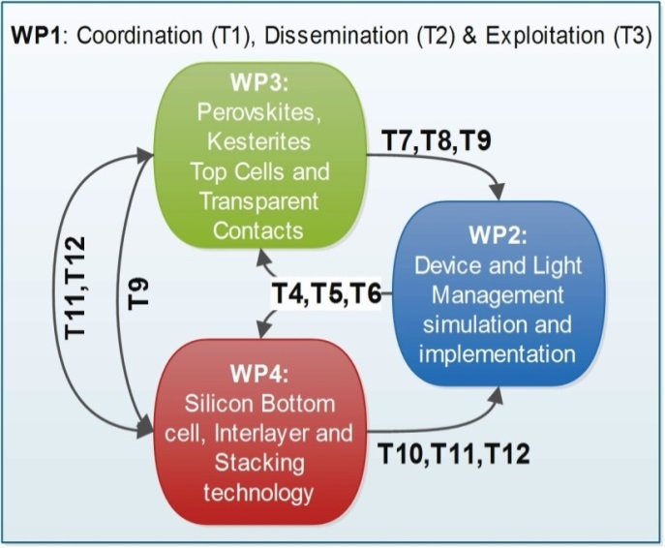
WP1 Activities
WP1 - Coordination, Dissemination and Exploitation
T1 – Project Management (UNINOVA) – M0-M36
T1.1 – Communication Management (Reports, publications, conferences)
T1.2 – Organization of Meetings (at least 1 per year)
T1.3 - Data Management, Monitoring of Project Activities and Reporting
T1.4 - Legal, Financial and Administrative Management
T1.5 - Quality and Risk Assessment Management
T2 – Communication & Dissemination (CENIMAT) – M5-M36
Website update (http://sites.fct.unl.pt/altaluz)
Peer-reviewed publications
Workshops and conferences (e.g. Jornadas CENIMAT - http://eventos.fct.unl.pt/jornadascenimat/)
Open days and summer schools (e.g. Ciência Viva in 11-15 July)
T3 - IPR Promotion and Exploitation Management (LNEG) – M12-M36
T3.1 - IPR Promotion and Innovation Management
T3.2 - Exploitation Plan & Technology Transfer

Slide 4
WP2 Activities
WP2 - Device Simulation and Light management
T4 – Modelling 4-terminal double-junction architecture (LNEG) – M0-M18
Simulation of individual sub-cells (both top and bottom separately)
Simulation of tandem cells (top + bottom)
Simulation of complete module circuitry
Optimization of module architecture and cell parameters
T5 – Light trapping simulation and optimization (CENIMAT) – M0-M24
Optimization of light trapping structures (Dielectric semi-prolates and PBRs) for individual bottom cells
Optimization of optical structures for the tandem device (Dielectric in front and PBRs in rear)
Optimization of complete device using optical (FDTD) + electrical (FEM) simulations with Lumerical
T6 - Implementation of light trapping structures (CENIMAT) – M7-M35
Dielectric semi-prolates - Colloidal Lithography and possibly Nano-imprint (stamping)
Plasmonic back reflectors (PBRs) – thin film annealing and possibly colloidal self-assembly with Ag NPs

Slide 5
WP3 Activities
WP3 - Perovskites and Kesterites Top cells
T7 – Perovskite top cell (LNEG) – M0-M30
Achievement of high-bandgap (>1.7 eV) Perovskite material
Achievement of high-bandgap (>1.7 eV) Perovskite solar cell
Implementation of light trapping (Dielectric semi-prolates by colloidal lithography)
Integration of Perovskite solar cell in tandem device
T8 – Kesterite top cell (LNEG) – M0-M30
Achievement of high-bandgap (>1.8 eV) Kesterite material (with Sb) via powder milling
Achievement of high-bandgap (>1.8 eV) Kesterite solar cell
Integration of Kesterite solar cell in tandem device (possibly with light trapping)
T9 – Transparent Electrodes (UNINOVA) – M6-M34
Investigation of best properties of front and intermediate TCOs (similar N to avoid reflections)
Fabrication and characterization of optimized TCOs and optical coupling with interlayer

Slide 6
WP4 Activities
WP4 - Silicon Bottom cell and Tandem integration
T10 – Microcrytalline Silicon bottom cell (UNINOVA) – M3-M21
High efficient mc-Si:H n-i-p and p-i-n cells for operation under red-NIR illumination (λ~700-1200 nm)
Implementation of light trapping (Ag NPs PBRs by thin film annealing and colloidal self-assembly)
Integration of mc-Si:H solar cells in tandem device
T11 – Intermediate layer optimization (LNEG) – M13-M36
Investigation of best optical properties for the interlayers of both approaches
Interlayer A - ~50nm-thick SiO_{x} or SiC_{x} layer, deposited on the rear surface of the top cell
Interlayer B - adhesive transparent polymer (e.g. epoxy deposited by spin-coating to form a thin film)
T12 – Stacking 4-terminal tandem cells (UNINOVA) – M20-M36
Approach A – conformal growth of bottom cell on a top cell (both superstrate-type)
Approach B – mechanical stacking of substrate-type bottom-cell and superstrate-type top-cell
Fabrication of 4-terminal test modules with optimized simulated design

Slide 7
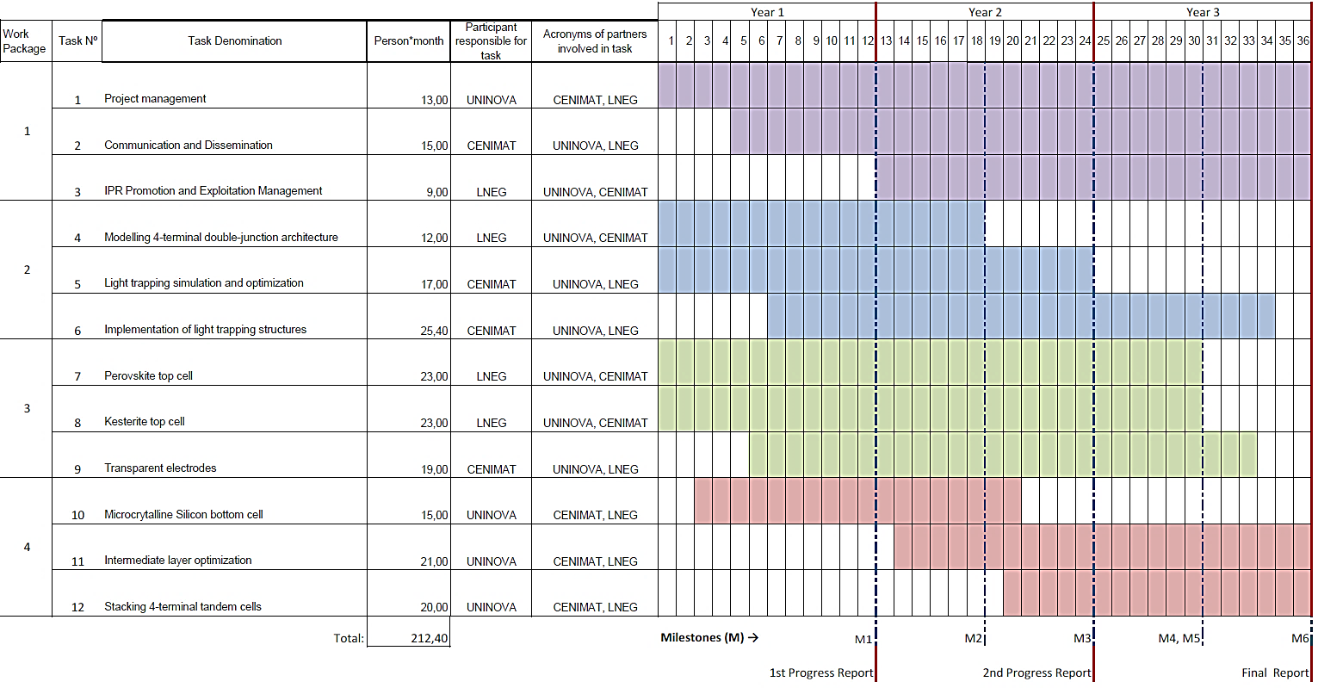
Timeline – T4, T5 & T10 should be finished
WP1
WP2
WP3
WP4

Slide 8
Previous and on-going developments
WP1
T1 – Project Management (UNINOVA M0-M36) – OK
T2 – Communication & Dissemination (CENIMAT M5-M36) – OK
T3 - IPR Promotion and Exploitation (LNEG M12-M36) – Need plans and deadlines
WP2
T4 – Modelling 4-terminal double-junction (LNEG M0-M18) – output needed (article + conference presentation)
T5 – Light trapping simulation (CENIMAT M0-M24) – 1 article published, 1 in revision (S. Haque) & 1 on-going (Master)
T6 - Implementation of light trapping (CENIMAT M7-M35) – 1 article published, 1 in revision & 1 on-going (O. Sanchez)
WP3
T7 – Perovskite top cell (LNEG M0-M30) – 1 article in revision (MJ. Brites), another article needed with PSC device (LNEG)
T8 – Kesterite top cell (LNEG M0-M30) – 1 article submitted (F. Neves), another article needed with Kesterite cell (LNEG)
T9 – Transparent Electrodes (UNINOVA M6-M34) – 1 article published, 1 under preparation (with Catania - Giacomo)
WP4
T10 – Microcrytalline Si bottom cell (UNINOVA M3-M21) – 1 submitted (A. Araujo), article to be finalized (J. Costa)
T11 – Intermediate layer (LNEG M13-M36) – 1 simulation article in prep. (Master), experimental article needed (LNEG)
T12 – Stacking 4-terminal tandems (UNINOVA M20-M36) – need to start the activities

Slide 9
Indicadores previstos e realizados
Proposed: | Y1 | Y2 | Y3 | Total | Done: | Crucial deliverables for Y3:
Artigos internac. | 2 | 4 | 6 | 12 | 7 | LNEG: T4, m18 (A. Joyce) – Modelo Módulo 4T UNINOVA: T10, m18 (J. Costa) – NIR uc-Si cells CENIMAT: T12, m34 (All) – 4-T tandem stacks
Conferenc. Internacion. | 3 | 5 | 7 | 15 | 8 | LNEG: T4 (4T Model), T8 (Kesterites), T11 (Intermediate layer) UNINOVA: T10 (uc-Si thin film cells), T12 (tandem stacks)
Relatorios | 1 | 1 | 1 | 3 | 2 | UNINOVA: T1
Organiz. seminarios | 1 | 1 | 1 | 3 | 2 | Jornadas CENIMAT-i3N (Y1) + Jornada do LNEG (Y2)
Modelos e aplicações | 1 | 2 | 0 | 3 | 1 | LNEG: T4 (Modelação de módulos com 4T 2J) CENIMAT: T5 (Aplicação simulação de LT em 4T 2J)
Prototipos | 0 | 2 | 4 | 6 | 1 | LNEG: T7 (Perovskite top cell) + T8 (Kesterite top cell) UNINOVA: T12 (4-T double-junction prototypes)
Patentes | 0 | 0 | 1 | 1 | 0 | Patent will not be issued, funding transference approved

Slide 10
Thank you!
10
FUNDING:
FEDER funds (COMPETE 2020 Program) and Foundation for Science and Technology (FCT-MEC) - PTDC/CTM-ENE/5125/2014, UID/CTM/50025/2013, PEst-C/CTM/LA0025/2013-14 and PTDC/ CTM-ENE/2514/2012.

